Slide 1
Cloud-Native Platform Engineering on Azure
Will Velida | @willvelida
Lead Software Engineer and Microsoft MVP
March 2025

Slide 2

Whoami?
Lead Software Engineer @ Mantel Group
Microsoft MVP (Specializing in Kubernetes and Open Source)
Check me out on BlueSky: bsky.app/profile/willvelida.com
I also post on YouTube: youtube.com/@willvelida

Slide 3



We have strict requirements for our cloud apps. We need to run audits before you even think of creating a DEV environment
Read the wiki for our shared app services. We’re updating them all the time, so keep an eye on it
This is madness! I have deadlines and I just want to code!
Architecture
Cloud Ops
Got security questions? Sure, we have weekly office hours, let’s wait till then
Our DevOps team is slammed. We can set you up with a pipeline, but we’ll need to schedule some time to discuss your requirements
You
Security
DevOps

Slide 4
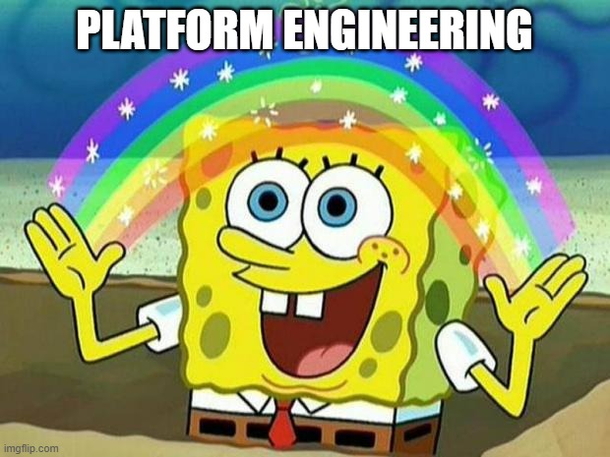
What’s the answer to this?

Slide 5
What is Platform Engineering?
Platform Engineering builds on DevOps principles to enhance security, compliance, costs, and time-to-value through self-service and a governed framework.
Industry Momentum: Gartner predicts 80% of engineering orgs will have platform engineering teams by 2026, focusing on internal developer platforms.
Accelerating Business Value: Platforms scale across domains (e.g., Dynamics, Salesforce, Twilio) to streamline operations and reduce delivery time.
Developer Enablement: Internal platforms improve developer experience through self-service tools, reusable patterns, and early security feedback.
Operational Simplicity: Platforms reduce toil by abstracting infrastructure, automating workflows, and managing developer tools.

Slide 6
“Platform Engineering is what DevOps should have been from the start – Just making it easy for Software Engineers to do their damn jobs and enjoy doing it. Except this time, we threw in some more jargon that recruiters love for some reason and are willing to pay us more for essentially the same work as we did as ‘DevOps Engineers’. But who am I to complain, I’ve got a wedding to pay for!”
Will Velida, 2025

Slide 7
How easy is it for your developers to do their jobs?

Slide 8
But seriously….
Self-service with guardrails
Culture shift to product mentality
Helping developers deliver business value quickly through self-service.
Secure, governed development with flexibility.
Rapid project and team onboarding that’s secure.
Simplified shared APIs, service discovery etc. across teams.
Improved collaboration while maintaining tool choice
Optimization of costs
Engineering Platform managed as a product.
Developers are your primary customer.
Automate as much as possible (Everything-as-Code).
Security, architecture, and operations are also key!

Slide 9
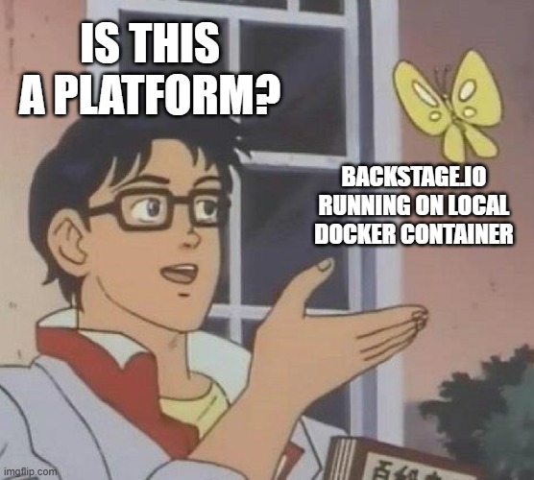
What makes an platform?
Internal Developer Platforms
Golden Paths to Production
Automation & Self-Service
Product Mindset
Centralized Expertise
Notes:
Internal Developer Platforms (IDPs) define recommended, supported paths to production, incrementally paving them to improve safety, velocity, and scalability.
Golden Paths guide developers through critical requirements while maintaining delivery speed, reducing cognitive load, and ensuring compliance.
Automation & Self-Service streamline operations, allowing teams to focus on building while ensuring governance, security, and efficiency.
Platform Engineering Mindset combines DevOps and DevSecOps principles with a product approach to create scalable, developer-friendly tools.
Centralized Expertise reduces manual steps, eliminates infrastructure concerns for teams, and enhances efficiency, security, and compliance.

Slide 10
The Principles that drive Platform Engineering
Each “customer” is important.
Adopting a “product” mindset.
Empowering developers through self-service.
Improving discovery of assets

Slide 11
Each “customer” is important
Notes:
One key principle of platform engineering is to optimize for your customers. Think of developers as your primary customer and focus on their needs first when deciding what development paths you want to pave and what capabilities you want to grow. Developers all use different tools to get their work done. As a first step, start small and evaluate whether you can improve existing screens and surfaces before implementing a brand new internal developer platform.

Slide 12


Congrats! Developers have been promoted to customers!
Empowering developers with “customer-centric” internal platform.
Identify optimal development paths
Meet users where they are
Notes:
Empower developers with a customer-centric internal platform
One of the key principles of platform engineering is thinking of developers as your customers.
The Team Topologies model calls them stream-aligned teams—this includes software engineers, machine learning professionals, and data scientists.
Just like any product team, we need to optimize for our customers—understanding their needs, pain points, and workflows to create a platform that truly supports them.
A successful platform does more than just provide tools—it empowers both developers and operators.
Developers gain autonomy to ship value quickly.
Operators ensure the platform is secure, compliant, and efficient without being a bottleneck.
To scale expertise, we codify best practices from operations, security, compliance, and architecture teams into templates and reusable system capabilities.
This reduces cognitive load for developers.
Improves security, compliance, and quality.
Allows specialists to focus on higher-value problems instead of answering the same questions repeatedly.
But at the core, everything comes down to developer experience.
A well-designed platform makes it easier for developers to do the right thing.
When the experience is frictionless, adoption happens naturally, and the platform delivers real business value.

Slide 13
What are we trying to achieve here?
Be clear on what your organization wants to gain from platform engineering.
Scope them to business objectives, rather than just development teams.
At a high level, this could be:
Increase app quality, reduce bugs and issues.
Improve security, reduce security incidents, or detected CVEs.
Decrease risk through better compliance.
Accelerate delivery times.
Reduce costs through improved automation
Agreeing on OKRs with leadership and developers helps drive the direction of your internal platform

Slide 14


What’s your desired path?
How do we want to get this into production?
IDE
Source Control
CI/CD
Application Infrastructure
Monitoring and Observability
Notes:
Speaker Notes: Establishing Your Desired Paved Paths
1. Defining Paved Paths in Your Organization
Many organizations already have multiple engineering tools and systems in place.
Early on, you need to decide whether to consolidate tools into a unified system or support a constellation of different tools.
A constellation approach works well—it allows flexibility while still defining paved paths that provide structure and guidance.
2. Adopting a Product Mindset
Think of your paved paths as managed services for development teams.
Teams that deviate from paved paths can still use their own tools, but they will be responsible for maintaining and paying for them.
This allows new tools to enter the ecosystem without disruption—they can be evaluated for inclusion over time.
3. Platform Engineering in Practice
Quote from Mark, platform engineering lead: "You can still do your own thing but do it in a direction we're going… you can change whatever you want, but this becomes your responsibility. You own the changes – you own the sharp knives."
The goal isn’t to enforce strict mandates but to encourage teams to naturally migrate to paved paths by demonstrating their benefits.
4. Balancing Flexibility & Standardization
Fully paved paths = golden paths (widely supported, scalable, and easy to use).
Partially paved paths = areas where teams have flexibility to adjust for unique needs.
If there’s no unique requirement, teams will naturally migrate to paved paths over time because they reduce effort and maintenance.
5. Consolidation Strategy & Migration
If your organization prefers consolidation, migrating existing applications can be time-consuming.
A good approach is to start by paving paths for new projects—over time, teams on the unpaved path will see the benefits and move over.
This leads to a "get right" campaign, where platform teams work with dev teams to migrate efficiently and gather feedback.
6. Avoid Mandating Paved Paths
The best way to get teams on paved paths isn’t through forced adoption.
Instead, focus on demonstrating the value paved paths provide—better efficiency, reduced toil, and streamlined compliance.
"Get right" campaigns facilitate two-way conversations and help teams switch at their own pace, ensuring a positive experience.

Slide 15
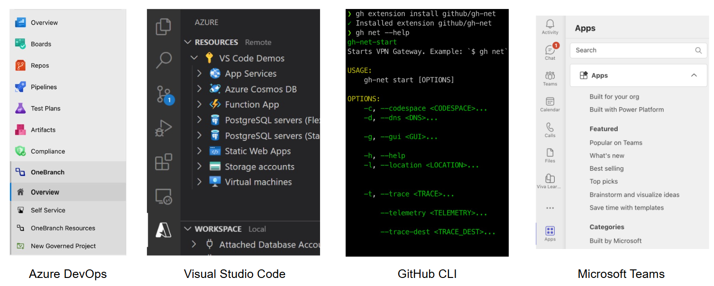
What tools do we already use?
It’s easier to extend what you have, rather than introduce something new
Notes:
evaluate whether you can enhance and extend what you have before you start building new experiences from scratch. (Ask yourself, will people react better to another new user experience or an improved version of something they have now?)
Some of the tools, utilities, or web apps you want to continue using will be custom, and these are good candidates for enhancement. But don't forget to pay attention to whether your favorite tools and services have an extensibility model you can use.
You'll get a lot of benefit from starting there. This can eliminate maintenance and security headaches and let you focus on the problem you're trying to solve
For example, you might be able to extend the following surfaces you're already using:
Editors and IDEs.
Your DevOps suite.
CLIs are increasingly extensible too.
Low/no-code environments like Power Pages.
Each might provide a better starting point for a given role than something you set up from scratch since they're existing centers of gravity.

Slide 16
Adopting a “product” mindset

Slide 17

What does that even mean?
Providing a great DevEx for our Developers
They should want to use the tools that make up our platform.
Platform Engineers working alongside developers on improving that experience
Measuring the “product”
Ensuring that the platform delivers the value we want
Notes:
Speaker Notes: Driving Internal Adoption with Product-Led Growth (PLG)
1. Applying Product-Led Growth (PLG) to Platform Engineering
In traditional PLG, companies like Figma and Shopify grow by creating highly valuable, easy-to-adopt products that spread organically.
The same principle applies to internal developer platforms—your goal is to make adoption go viral within your company.
Instead of mandating usage, your platform should be so valuable that developers naturally choose it.
Platform teams must think like product owners, with developers as their end customers.
2. Creating a “Delightful” Developer Experience
Developers should want to use the platform—not be forced into it.
Focus on removing friction, streamlining workflows, and empowering operators to collaborate easily.
Use customer development processes to test hypotheses and understand what developers and stakeholders truly need.
3. Adopting a Product Mindset
Quote from Mark, platform engineering lead: "We manage like a product … Our team is focusing on answering [development team] questions that have nothing to do with [their application’s] business case."
This mindset means platform teams build tools that enable developers to handle security, compliance, and operational needs—without distracting from their core business goals.
The platform becomes the critical glue between development and operations.
4. Measuring Success with Data-Driven Metrics
To prove platform effectiveness and retain talent, define key success metrics:
Speed – How fast do teams deliver business value?
Quality – How does the platform improve product reliability?
Ease of use – How seamless is the developer experience?
Go beyond just satisfaction—measure whether developers are thriving with the platform.
Use capability retention & usage metrics to assess the impact of platform investments.
5. The Big Takeaway
A developer platform should be treated as a product—not just an IT project.
Adoption should be organic, driven by genuine value and ease of use.
By delighting developers and tracking success through key metrics, your internal platform can become indispensable within your organization.

Slide 18
How do we know if we’re doing this right?
Some metrics that we can use to evaluate platform engineering efficiency
Speed/time to business value
Median days to complete a PR
Median minutes for build/test processes
Median time to merge PRs
Software Quality
Issues created per month per dev
Mean time to remediate
Mean time to investigate security issues
Ease of use of the Platform
Net user satisfaction (NSAT)
Ecosystem quality
Qualitative survey questions “I’m empowered by the platform”

Slide 19
Empowering through self-service
Notes:
Self-service with guardrails is the principle of empowering development teams to make their own decisions within a set of well-defined parameters, or guardrails. Guardrails are established and agreed to by key stakeholders. Stakeholders can include security, operations, architecture teams across the organization.
With self-service with guardrails, development teams retain autonomy to independently make development decisions. Automation and policy help stakeholders ensure that security, compliance, operations, standards, and costs are properly managed. Enabling this automation requires collaboration across team lines so that developers, operators, and specialists can do more, without sacrificing the needed governance. Developers can then focus on delivering business value as quickly as possible

Slide 20
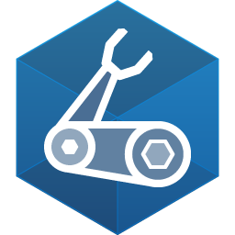
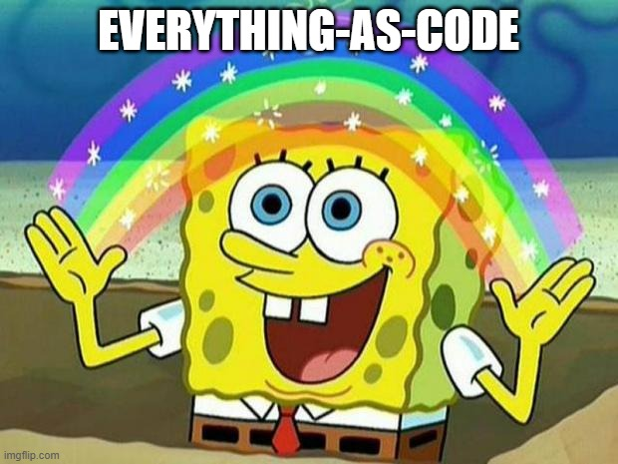
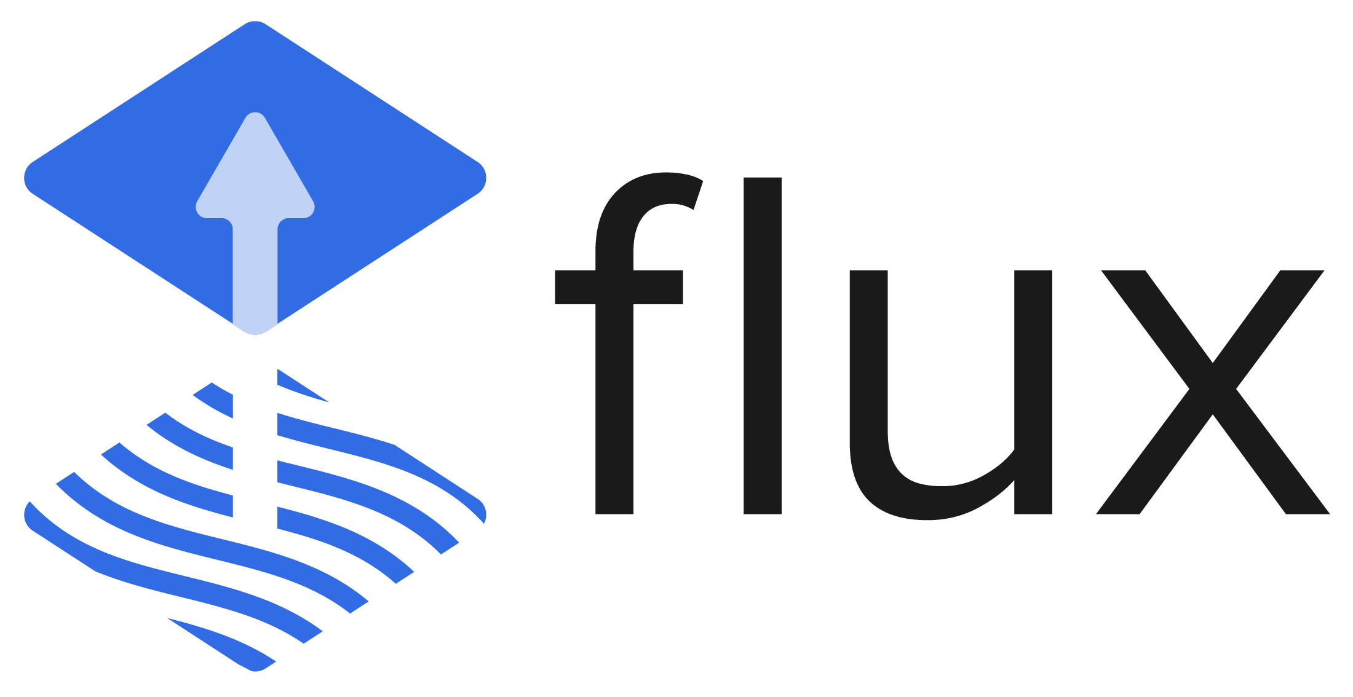
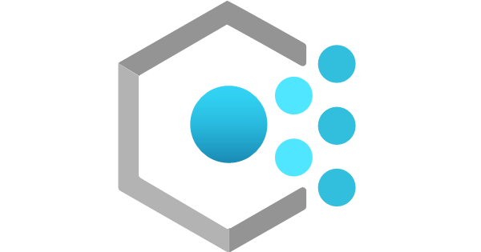
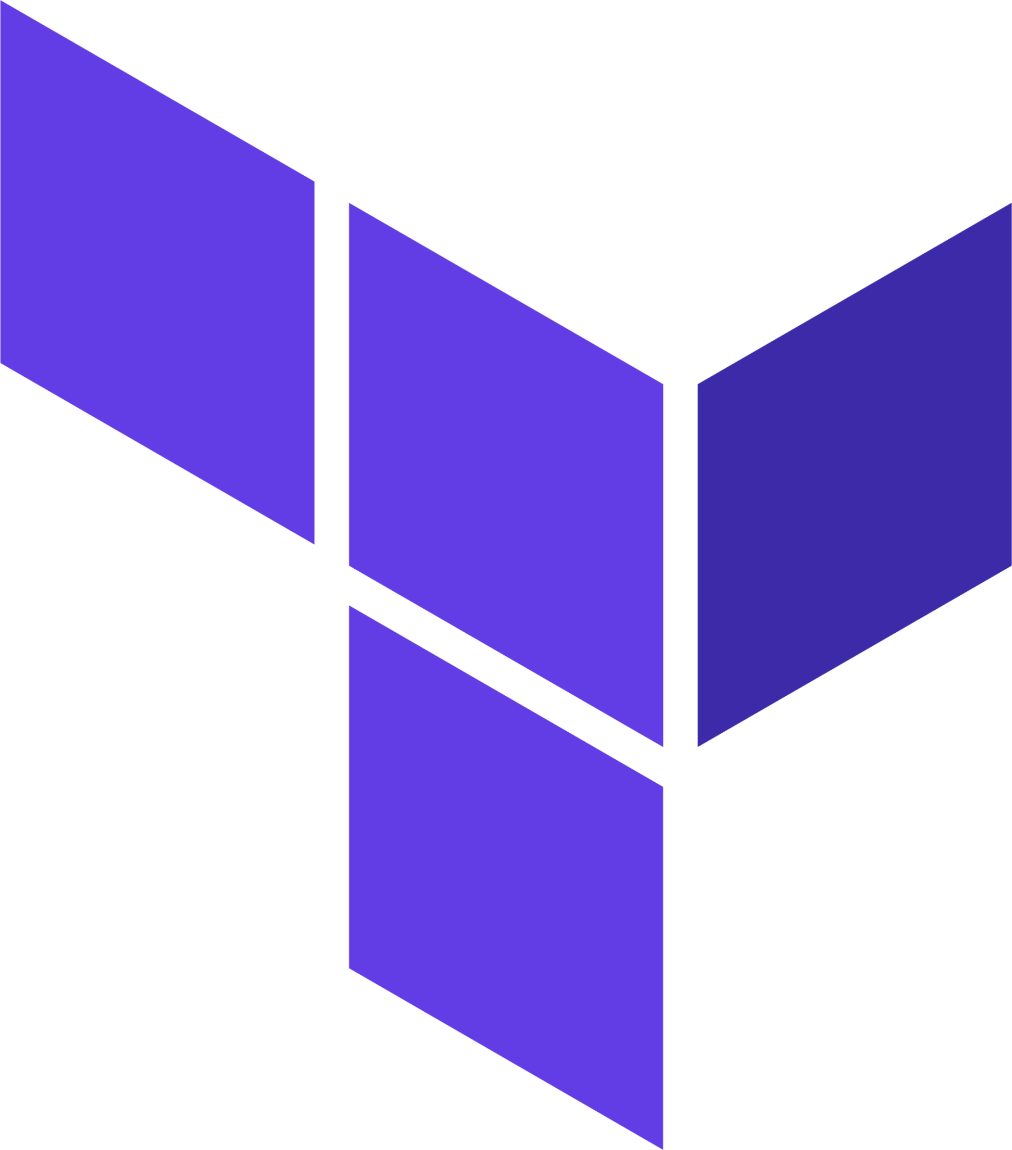

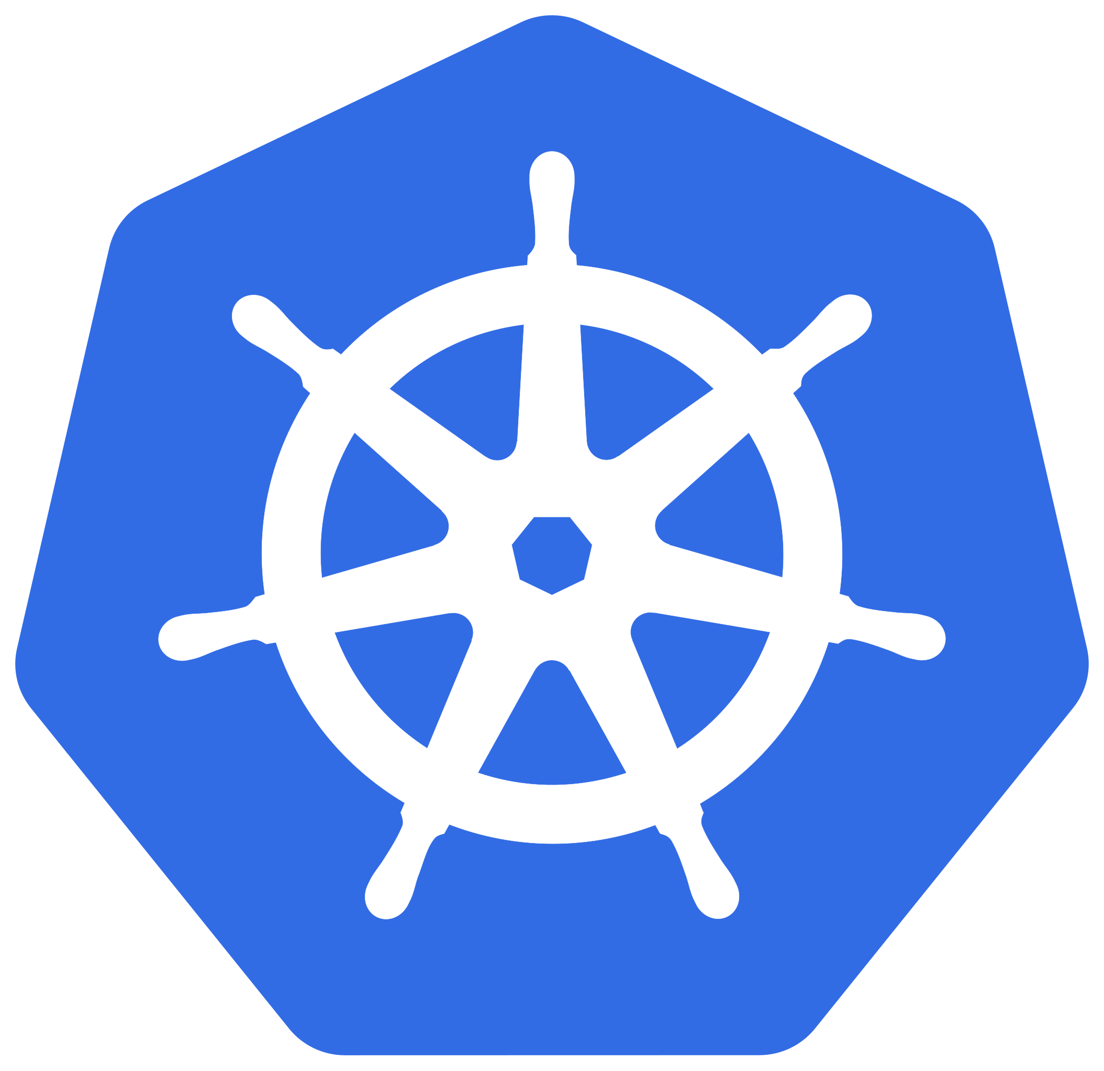

Everything-as-code pattern
Notes:
Speaker Notes: Enabling Self-Service with Infrastructure as Code (IaC) and GitOps
1. Why IaC is Critical for Self-Service
Infrastructure as Code (IaC) with Continuous Delivery (CD) pipelines and GitOps tools helps enable self-service provisioning.
Developers can use tools like Bicep, Terraform, and Helm charts to create and destroy cloud resources on demand.
Because cloud configuration is treated as code, it benefits from:
Version control – Track changes over time.
Security & auditability – Review who made changes and why.
Automation – Reduce manual infrastructure work and prevent drift.
2. Extending the ‘As Code’ Approach Beyond Infrastructure
IaC isn't just for provisioning infrastructure—the same concept can be applied to:
Security as Code – Automate security configurations.
Policy as Code – Enforce governance with tools like Azure Policy and Open Policy Agent (OPA).
How it works:
Developers push a YAML or JSON configuration to a repository.
A workflow is triggered that processes the file and enforces policies automatically.
Examples:
dependabot.yml (automating dependency updates).
CODEOWNERS (defining code review responsibilities).
Centralized policy repositories for governance enforcement.
3. Everything as Code (EaC) and Self-Service
By adopting Everything as Code (EaC), you create a centralized catalog of reusable templates.
Developers can self-serve infrastructure, security, and policies while adhering to best practices by default.
This approach reduces cognitive load, allowing developers to focus on delivering value instead of managing configurations.
4. Key Takeaway
IaC + GitOps + Self-Service = Empowered Developers & Scalable Infrastructure
Automate everything to improve speed, security, and governance.
Enable developer self-service by offering a curated set of best-practice templates.

Slide 21
Start Right, Stay Right
Start Right
Automated policy, scanning, and governance
“Stay Right”
Development Teams
Notes:
Speaker Notes: Start Right Templates & Stay Right Governance
1. Applying Software Design Principles to Platform Engineering
In software development, we emphasize encapsulation, modularity, and composability to build scalable and maintainable applications.
The same principles apply to platform engineering—by using templating for infrastructure and application setup.
2. Start Right with Secure, Reusable Templates
Centrally secured, reusable Infrastructure as Code (IaC) templates act as building blocks for infrastructure provisioning.
These templates allow developers to focus on application code rather than managing the underlying infrastructure.
Example:
Pre-approved Terraform/Bicep modules for networking, storage, and security.
Pre-configured CI/CD pipelines with best practices baked in.
Quote: "We will build out modules for our [developers]… so instead of having to write or worry about any of the backend themselves, all they need to do is worry about their application code." — Daniel, Cloud Engineer, Fortune 500 Media Company
3. Everything as Code (EaC) for a Seamless Developer Experience
Combine IaC, EaC, and application templates into a tailored, Everything as Code (EaC) solution.
Extend EaC beyond infrastructure to other activities:
Automated source code repository creation with sample projects.
Pre-configured observability tooling (e.g., logging & monitoring setup).
Security and policy configurations enforced as code.
4. Where to Store & Manage Templates?
Store or reference IaC, EaC, and application templates from secure, central locations like:
Git repositories (e.g., GitHub, Azure Repos).
Azure Deployment Environments (ADE) catalogs for cloud infra.
Azure Container Registry (ACR) for cloud-native applications.
5. Stay Right with Automated Governance
Once start right templates are in place, combine them with:
Automated policy enforcement (e.g., Azure Policy, Open Policy Agent).
Continuous security scanning and compliance checks.
CI/CD guardrails that ensure best practices are followed from Day 1.
Key Takeaway:
Start Right: Provide developers with pre-built, best-practice templates.
Stay Right: Automate governance, security, and compliance to keep everything on track.

Slide 22
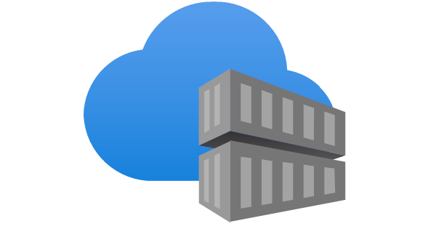
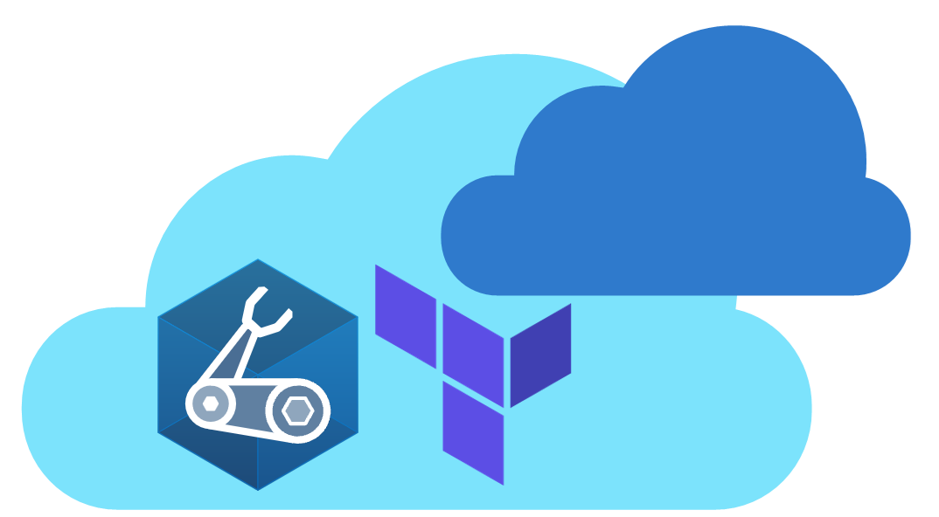
Public and Private Bicep Modules
Azure Verified Modules
Private ACR for custom modules
Initiative from Microsoft to consolidate and set standards for “good” infrastructure-as-code.
AVM enables consistent development and deployments of cloud native applications by codifying Well-Architected Practices.
Provides both Resource and Pattern modules.
Available for both Bicep and Terraform
To share your own modules within your organization, you can create private Azure Container Registry modules.
Developers can then use read access to build infrastructure required.
Granular control over module lifecycle (versioning, tags)

Slide 23
Team
Collaboration
Infrastructure Recipes
Application
Graph
Cloud
Neutral
Radius Application and Environments allow developers to work with operations on application definition + delivery
Swappable infrastructure with popular IaC tools that follows org best practices and IT policy
by default
Understand
how services and infrastructure in an application are interconnected
Deploy across development, on-premises, and cloud environments with a consistent experience
Notes:
Radius is designed to enable platform engineers and developers to collaborate on building cloud-native applications. The abstraction unit here is what we call recipes, which are swappable pieces of infrastructure that follow your organization’s best practices and configuration by default.

Slide 24
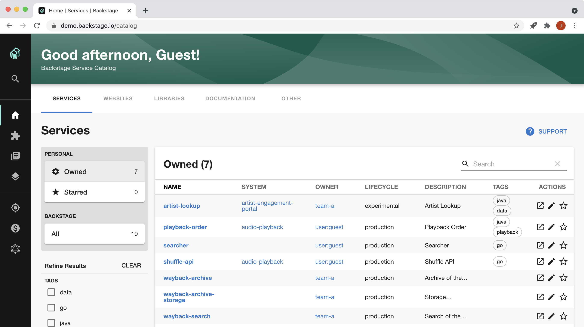
Notes:
The ultimate step beyond all of this are portals like backstage, where you have an actual portal you go to to simplify a software development workflow from artifacts that you store in a software catalog.
Key Features:
Software Catalog: A centralized repository for all software components, services, libraries, and data pipelines.
Developer Portal: A unified interface for accessing and managing infrastructure tooling, services, and documentation.
Software Templates: Tools for creating new components and services using pre-defined templates.
Plugin Architecture: Backstage is designed to be extensible through plugins, allowing users to integrate various tools and services.
Benefits:
Improved Developer Productivity: Streamlines workflows, reduces cognitive load, and makes it easier to onboard and manage software.
Enhanced Collaboration: Provides a central hub for information sharing and collaboration among developers.
Increased Autonomy: Enables product teams to ship high-quality code quickly without compromising autonomy.

Slide 25

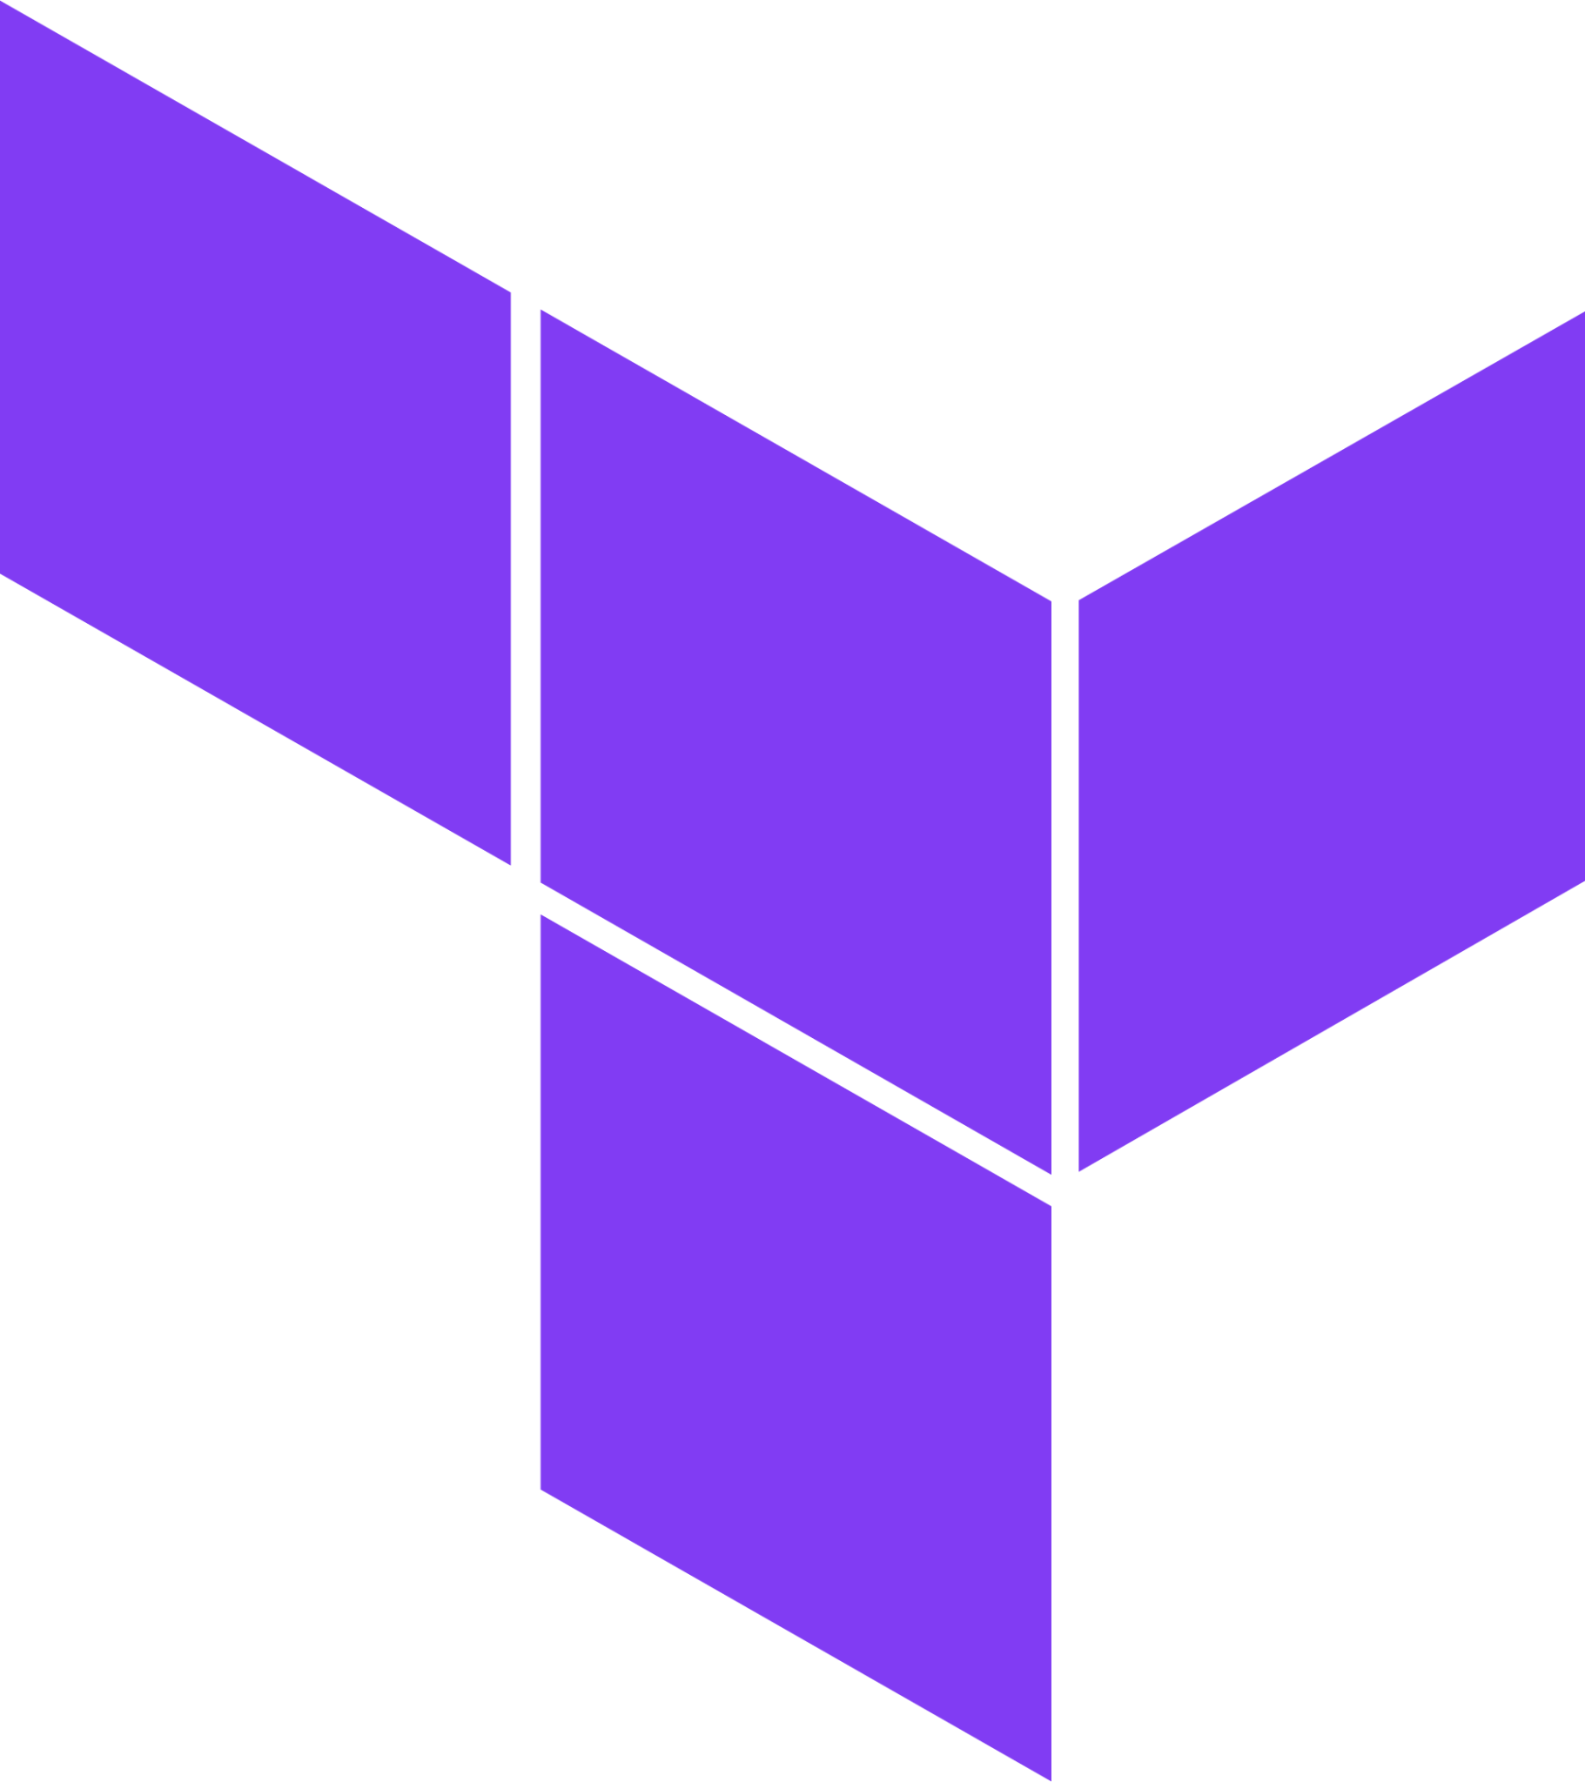
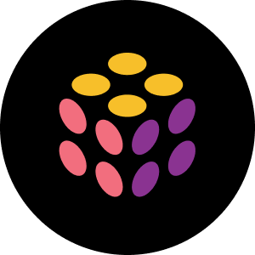
What are Azure Deployment Environments?
Infrastructure-as-code Template Catalog
On-Demand Environment
Sandbox Environment
Azure Mappings
Dev Infra Teams
Create templates and map projects to Azure subscriptions, identities, and permissions
Subscription
Developers
Deploy environments using templates based on current stage of development
CI/CD Pipeline Environments
Identity
Permissions
Notes:
Azure Deployment Environments essentially help development teams to quickly and easily spin up app infrastructure using project-based templates that establish consistency and best practices while maximizing security. This on-demand access to secure environments accelerates the different stages of the software development lifecycle in a compliant and cost-efficient way.
A deployment environment is a collection of Azure infrastructure resources defined in a template called an environment definition. Developers can deploy infrastructure defined in the templates in subscriptions where they have access, and build their applications on the infrastructure.
Platform engineers can create and manage environment definitions. To specify which environment definitions are available to developers, platform engineers can associate environment definitions with projects, and assign permissions to developers. They can also apply Azure governance based on the type of environment, such as sandbox, testing, or production.
The following diagram shows an overview of Azure Deployment Environments capabilities. Platform engineers define infrastructure templates and configure subscriptions, identity, and permissions. Developers create environments based on the templates, and build and deploy applications on the infrastructure. Environments can support different scenarios, like on-demand environments, sandbox environments for testing, and CI/CD pipelines for continuous integration and continuous deployment.

Slide 26
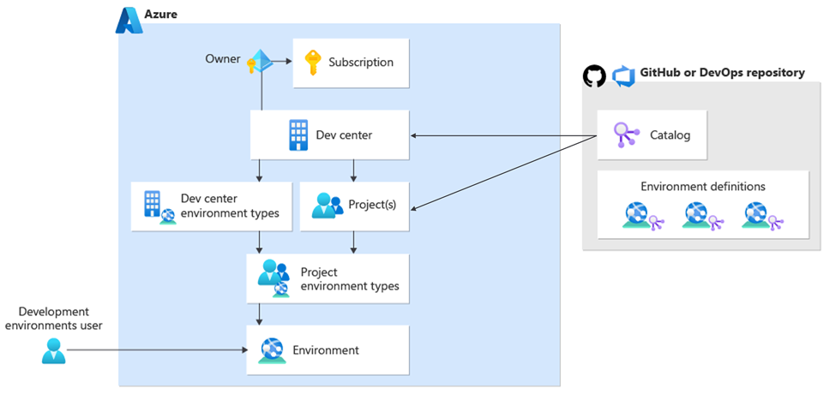
Notes:
Let’s take a look at the key components of Azure Deployment Environments.
Let’s start with the Dev Center. This resource contains a collection of Projects that require similar settings. As Platform Engineers, we can use dev centers to use catalogs to manage IaC templates that are available to projects, and use environment types to configure the types of environments that development teams can create.
Projects represent the team or business function within your organization. When you associate a project with a dev center, all the settings for the dev center are automatically applied to the project. Each project can be associated with only one dev center. Platform Engineers can configure environments for a project by specifying which environment types are appropriate for the development team. To make environment definitions available to a specific development team, admins of the Project can attach a catalog to a project. To allow developers to create their own deployment environments, we have to provide developers with access to the project.
Environments are a collection of Azure resources on which your application is deployed. For example, you might have an App Service, SQL database, Key Vault, App Insights etc. that makes up a web application. In your environment, you can have both PaaS and IaaS resources that supports your application.
With Azure Deployment environments, you can define the types of environments that development teams can create. This provides the flexibility to name your environments to match the one that your enterprise uses, along with the ability to configure settings for those environment types based on the needs of your development teams.
Project environment types are a subset of the environment types that you configure for the dev center. These help us configure the types of environments that specific development teams can create. Project environment types allow you to automatically apply the right set of policies on environments, and help abstract responsibilities from your development teams.
Catalogs help you provide a set of curated IaC templates for your development teams to create environments. You can attach a catalog to a dev center make environment definitions available to all the projects associated with the dev center. You can also attach a catalog to a project to provide environment definitions to that specific project. You can attach either a GitHub repository or an Azure DevOps Services repository as a catalog. Deployment environments scan the specified folder of the repository to find environment definitions. Those environment definitions are available to all the projects associated with the dev center.
Finally, An environment definition is a combination of an IaC template and an environment file that acts as a manifest. The template defines the environment, and the environment file provides metadata about the template. Your development teams use the items that you provide in the catalog to create environments in Azure.

Slide 27

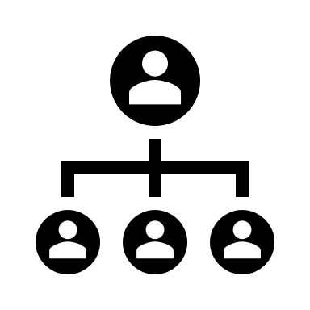





Introduction to Microsoft Dev Box
Platform Engineers
Dev team leads
Developers
Manage dev boxes via Microsoft Intune and Endpoint Manager
Set and manage security policies
Create pools of dev boxes tailored to projects and tasks
Configure dev boxes by project
Customize Developer Experience
Deploy dev boxes they need to work on projects and tasks
Deploy dev boxes from developer portals
Organizational Policies
Network Configuration
Security Policies
Notes:
Dev Box give developers self-services access to cloud workstations called dev boxes. You can configure these dev boxes with tools, source code, prebuilt binaries etc, that are specific to a project so that developers in your team can hit the ground running with their work immediately, so no more needing to wait 2 weeks for someone in security or identity to manually approve your corporate access!
You can use preconfigured images from the Azure Marketplace, or use your own customized images. As a developer, you can use multiple dev boxes for your work, and can access it through remote desktop clients, or web browsers like any virtual desktop.
Dev Box was created with three roles in mind. Platform Engineers, Dev team leads and developers.
Platform Engineers and IT admins work together to provide developers with the tools and infrastructure they need to do their work. This includes setting and managing security settings, network configurations, and organizational policies to ensure that the dev boxes can access resources securely.
Dev team leads will have in-depth knowledge about their projects. They can serve as Admins, and assist with creating and managing the developer experience. They also create and manage pools of dev boxes.
Then developers are the people who will use the Dev Boxes. Developers can self-serve one or more dev boxes on demand from the dev box pools that are enabled for a project. Dev box users can work on multiple projects or tasks by creating multiple dev boxes.
The intention behind Dev Box is to bridge the gap between development teams and IT operations teams, and prevent long waiting times just to get onboarded and get the work done!

Slide 28
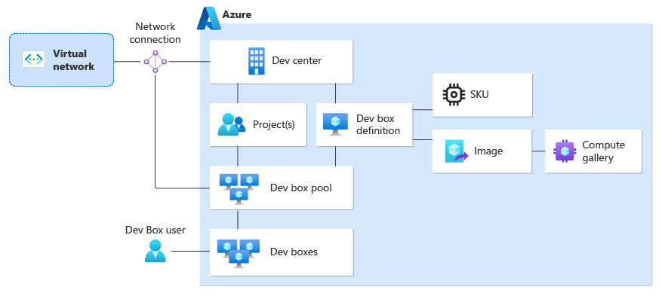
How does Dev Box work?
Notes:
So how does this all work? Well before developers can create dev boxes in the developer portal, we need to create a dev center and project in Microsoft Dev Box.
A Dev center is the top-level resource for Microsoft Dev Box. The Dev Center contains a collection of projects and the shared resources for these projects, such as dev box definitions and network connections. Technically there’s no limit of the number of dev centers that you can create, but usually we just only need one.
The dev box project is for our development teams. You assign a developer the Dev Box User role to a project to grant them permissions to create dev boxes. You can create one or more projects in a Dev Center.
A dev box definition specifies how our dev boxes will be configured, including the VM image and compute resources. As I mentioned earlier, these can be from the Azure Marketplace, or your own custom VM images.
Now projects will contain the collection of dev box pools. A dev box pool specifies the configuration of the dev box, which includes the dev box definition, network connection and other settings. All dev boxes that are created from a dev box pool will share the same configuration.
The network connection that’s associated with a dev box pool determines where the dev box is hosted. You can use either a Microsoft-hosted network connection, or you can bring your own Azure network. If you need control over the virtual network, require access to your own corporate resources etc. You’ll want to use your own Azure network connection.
Developers can create a dev box from the pool by using the developer portal, where they can choose boxes from a specific pool based on VM images, compute resources, or where the dev box is hosted.
Once the box is running, we can connect to it remotely by using a remote desktop client or directly from the browser.

Slide 29
Managing our platform assets
Notes:
As your organization grows, so does the amount of stuff you need to track. Organizations often have duplicated internal efforts because one team doesn’t know about the other one's project. As people move between teams, new people join the company and others leave, projects can become orphaned. Inventories help solve these issues and are a key part of platform engineering.
An inventory is a tool or system used to track, manage, and organize an organization's technical assets. These assets include code, APIs, containers, virtual machines (VMs), team permissions, and more.
Not keeping track of assets leads to technical sprawl and waste simply because you can't easily discover what already exists. Losing track of what already exists is a common challenge.

Slide 30
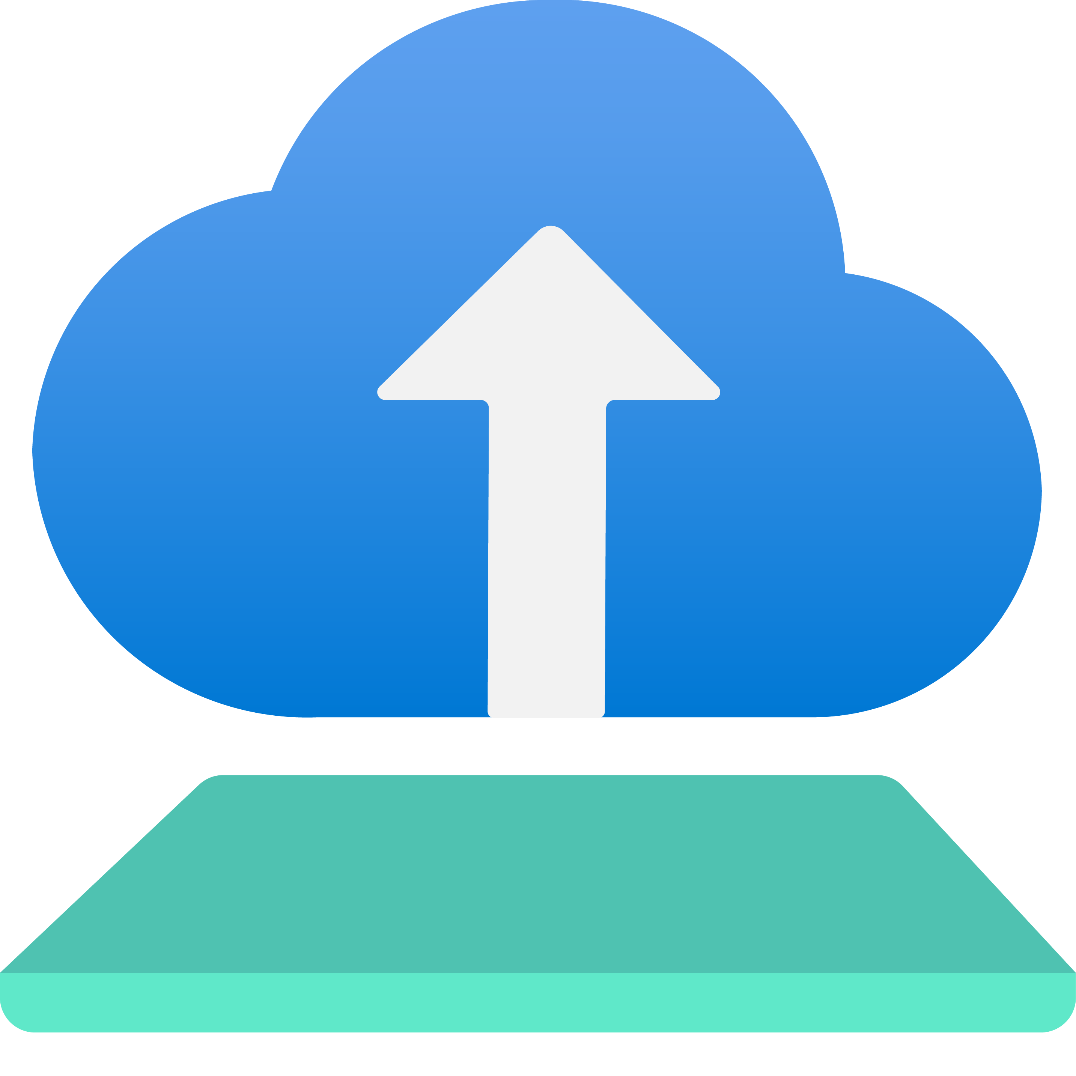
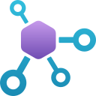

Tracking your assets
Azure Deployment Environments let you track complex infrastructure through IaC
Azure API Center and API Management provides ways to find and consume APIs
Package registries like GitHub Packages or Azure Artifacts improve supply chain security
Notes:
You need an inventory to track all the stuff that you’ve created or built in your ecosystem that internal customers can visualize in a comprehensible way.
An inventory can improve security, promote reuse, and generally make discovery easier. Different tools are available for tracking different types of assets. Each of these tools provides an inventory to help you manage, track, and clean up waste.
Available tracking tools include:
Azure Deployment Environments let you track complex infrastructure created through infrastructure as code (IaC) as an abstract environment.
Azure API Center provides a way for developers to discover and consume APIs.
Package registries like GitHub Packages or Azure Artifacts (or other inventories of approved packages and SDKs) improve supply chain security.
When deciding on the visibility of your inventories, consider the best approach for your organization. Some organizations allow all developers to see software assets, but only a few can modify them (similar to an open kitchen). Others, especially in regulated industries, restrict access more tightly, sometimes even limiting visibility to project names due to sensitivity.

Slide 31
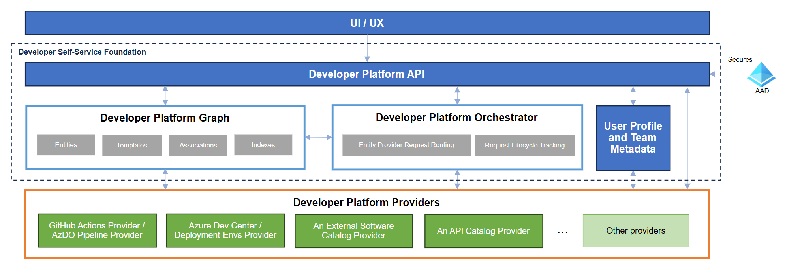
Developer Self-Service Platform Components
Notes:
Key Components of a Developer Platform
1. Developer Platform API – The System’s Contract
Acts as the single entry point for all user interactions.
Defines a contract with other systems, ensuring consistency and interoperability.
Provides a unified way for developers to interact with platform services.
Key Takeaway: The API is the foundation of the developer experience, enabling seamless integrations.
2. Developer Platform Graph – Centralized Data & Templates
Manages and secures a structured data graph for:
Discovering & associating entities.
Defining reusable templates for automation.
Entities aggregate data from multiple sources.
Templates define user inputs that drive automation.
Example:
A service entity might aggregate data from GitHub, Jira, and monitoring tools.
A deployment template could standardize CI/CD pipeline creation.
Key Takeaway: The graph enables data-driven decision-making and simplifies automation.
3. Developer Platform Orchestrator – Managing Requests
Routes & tracks requests based on templates.
Supports both automated and manual workflows.
Works with developer platform providers to integrate with workflow systems.
Example:
A developer submits a request to create a new microservice →
The orchestrator ensures all required infrastructure, repositories, and pipelines are created.
Key Takeaway: The orchestrator is the engine that connects user requests to actual execution.
4. Developer Platform Providers – Integration Layer
Encapsulate logic to integrate with different backend systems.
Support CRUD operations on entities and execute template-based actions.
Can emit unique or shared entity types based on the integration.
Example:
A provider for Azure DevOps handles repo creation, pipeline setup, and permissions.
A provider for Kubernetes manages cluster provisioning and configuration.
Key Takeaway: Providers extend platform capabilities to work with different tools and services.
5. User Profile & Team Metadata – Identity & Access Management
Stores information about users & teams to define access control.
Tied to identity providers (e.g., Microsoft Entra ID).
Can be implemented within the developer platform graph to persist user & team relationships.
Example:
A user’s profile can determine what services they can provision or which templates they can access.
Key Takeaway: Identity & team metadata simplifies governance by controlling platform access.

Slide 32
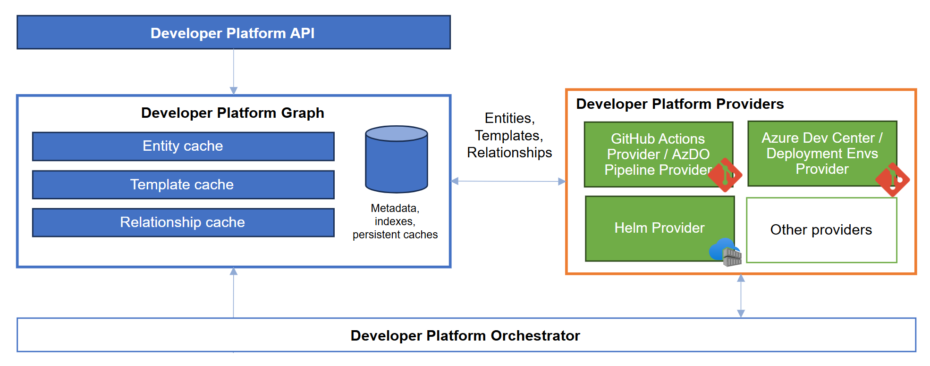
Developer Platform Graph
Notes:
Developer Platform Graph – Connecting Everything
1. What is a Developer Platform Graph?
A searchable, structured graph that links entities and templates from multiple providers.
Instead of persisting all data in a graph database, it caches interactions with providers and stores metadata to associate everything.
Key Takeaway: The graph connects data across tools without duplicating storage, making it flexible and scalable.
2. Why is the Graph Powerful?
Aggregates data from multiple providers into a unified view.
Allows dynamic associations between different system components.
Enables switching or adding providers over time without breaking functionality.
Example:
A list of APIs might come from Azure API Center.
Deployments and environments could be automatically fed from CI/CD systems.
If a company moves from GitHub Actions to Azure DevOps, the graph continues working as long as providers exist.
Key Takeaway: The graph provides a future-proof way to associate and discover platform components.
3. How Does the Graph Improve User Experience?
Powers a common API for discovery, search, and governance.
Enables a seamless developer experience across different providers.
Ensures developer platform orchestrators can trigger actions while keeping the system up to date.
Example:
A developer searches for an API → the graph pulls API details from Azure API Center, deployment status from CI/CD, and security policies from OPA.
When a deployment happens, the developer platform provider updates the graph, ensuring accurate data is available in the API.
Key Takeaway: The graph acts as the brain of the platform, ensuring data consistency and discoverability across all tools.

Slide 33
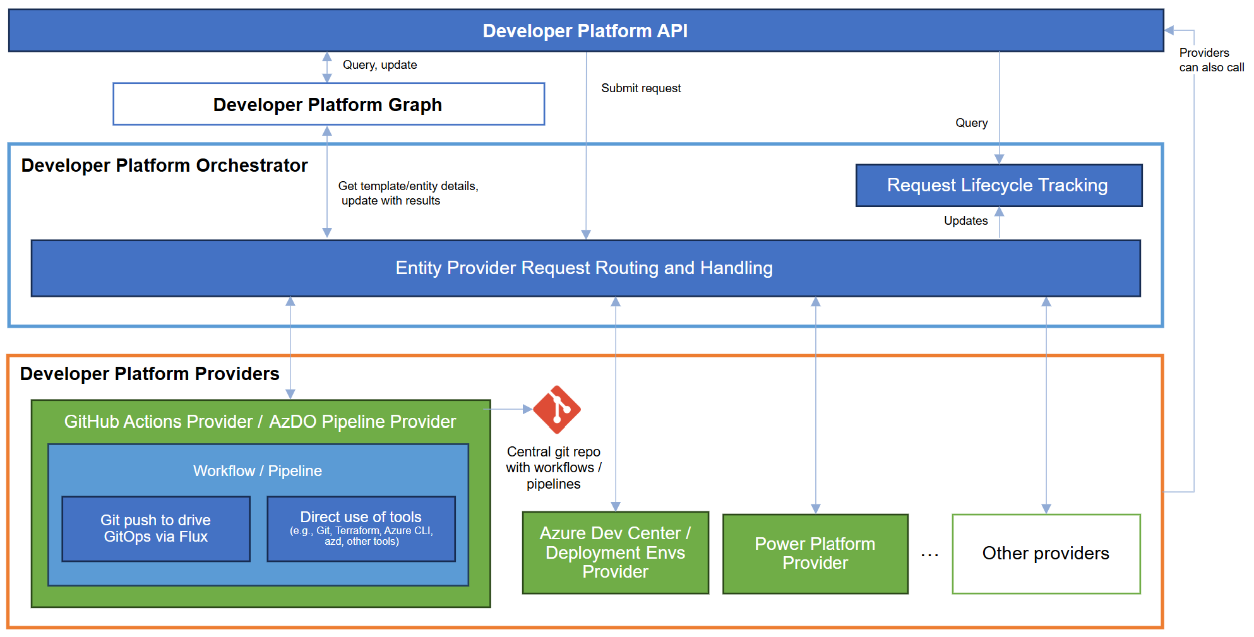
Developer Platform Orchestrator
Notes:
Developer Platform Orchestrator – Automating Developer Requests
1. What is a Developer Platform Orchestrator?
A coordination layer that enables developers and systems to trigger actions using templates.
Unlike CI/CD, these actions don’t have to be tied to source code—they can automate various workflows across the business.
Works by delegating tasks to workflow engines, task engines, or other orchestrators instead of executing them directly.
Key Takeaway: The orchestrator is a critical part of self-service automation, enabling standardized actions across the developer platform.
2. Why is an Orchestrator Essential?
Developers can request actions without needing direct permissions for execution.
Supports different workflow engines (e.g., GitHub Actions, Azure Pipelines, Power Automate).
Allows gradual migration between automation tools without disrupting existing workflows.
Example Use Cases: ✅ Triggering infrastructure provisioning using Terraform or Bicep templates. ✅ Onboarding a new developer by setting up repo permissions, CI/CD pipelines, and access controls. ✅ Automating business workflows like license management or expense approvals.
Key Takeaway: The orchestrator bridges automation across different teams, not just developers.
3. How Does the Orchestrator Work?
1️⃣ Developer selects a template and enters required inputs. 2️⃣ A request is created in the developer platform API. 3️⃣ The orchestrator routes the request to the relevant developer platform provider. 4️⃣ The developer platform provider executes the action using its own logic. 5️⃣ (Optional) The provider updates the request status as it progresses. 6️⃣ Once completed, the provider sends results to the developer platform graph (e.g., updated infrastructure, new permissions, or a completed business process). 7️⃣ (Optional) The provider triggers another related action, creating complex, multi-step workflows.
Key Takeaway: The orchestrator abstracts automation, ensuring scalability and flexibility across different tools.
4. Choosing the Right Orchestrator
Start with existing CI/CD tools (GitHub Actions, Azure Pipelines).
For business process automation, use low-code tools like Power Automate.
Use lightweight HTTP-based triggers when a full automation engine isn’t necessary.
Key Takeaway: Your choice of workflow engine should align with the action type and evolve as needs change.

Slide 34
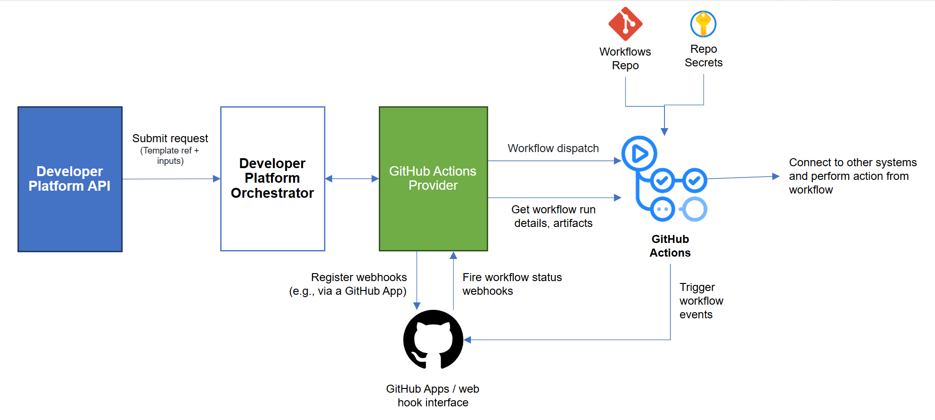
Examples
Notes:
Using GitHub Actions & Azure Pipelines as Developer Platform Providers
1. How GitHub Actions & Azure Pipelines Work as Developer Platform Providers
A developer platform provider can connect to a GitHub instance or Azure DevOps to trigger workflows.
This is done through:
GitHub Actions: Uses the REST API to trigger a workflow_dispatch event.
Azure Pipelines: Uses the Pipeline API to trigger runs.
Other automation tools (e.g., Jenkins, ArgoCD) have similar capabilities.
Key Takeaway: These workflows don't need to be in application repos—they can be centrally managed by platform teams.
2. How This Works in a Developer Platform
Centralized repositories store workflows, pipelines, and scripts—developers don’t need direct access.
Ops or platform engineers manage secrets (e.g., in Azure Key Vault or the repo’s secret store).
Workflows publish artifacts (build outputs, IaC state, metadata) to track completed actions.
Orchestrator watches workflow state, updating lifecycle status until completion.
The developer platform provider consumes artifacts & updates the developer platform graph.
Templates are registered in the platform, enabling self-service for developers.
Key Takeaway: This enables secure, managed automation where developers request actions without direct system access.
3. Why Use a CI/CD System as a Provider?
✅ Flexible execution – Run arbitrary CLIs, scripts, or IaC commands. ✅ Secure secrets management – Store & control credentials centrally. ✅ Standardized automation – Leverage existing workflows instead of building new ones. ✅ Scalability – Add first-class integrations over time only as needed.
Key Takeaway: You don’t need to use GitHub Actions/Azure Pipelines for CI/CD to leverage them as developer platform providers.

Slide 35
Recap

Slide 36
Coming back to the fundamental question
How easy is it for your developers to do their jobs?

Slide 37
If you take anything away from taking, just keep it simple
Self-service with guardrails
Culture shift to product mentality
Helping developers deliver business value quickly through self-service.
Secure, governed development with flexibility.
Rapid project and team onboarding that’s secure.
Simplified shared APIs, service discovery etc. across teams.
Improved collaboration while maintaining tool choice
Optimization of costs
Engineering Platform managed as a product.
Developers are your primary customer.
Automate as much as possible (Everything-as-Code).
Security, architecture, and operations are also key!

Slide 38
Platform Engineering Capability Model – Matrix intro
Platform Engineering Capability Model
How are staff and funds allocated to platform capabilities? Budget and Staffing - Scope Management – Measuring ROI | Unfunded Immediate needs only How urgent requirements are addressed | Teams are created Linted to specific concerns Size of backlog | Central teams founded Solutions to address needs across teams Speed of delivery | Team is staffed / managed like product teams Product roadmaps defined with engineering teams Improvements in developer satisfaction | Central platform teams encourages contributions Knowledge sharing organization-wide Improvements in developer satisfaction
How do users discover your platform engineering solution? Discover - Choose - Use | Informally, word-of-mouth Engineers choose and integrate services Teams maintain their own scripts and tools | Platform team guidance Informal discussions with the platform team Processes built around platform standards | Platform team directives Platform team encourage use of platform capabilities Solutions are shared in informal communities | Platform self-service Look to the platform for technical solutions Use is supported through templates, forums, docs | Advocates and internal user community is built Platform engineers participate in planning Engineering teams contribute fixes / feature
How do you ensure your users have access to capabilities they need and that costs, data, and IP are appropriately managed? Define Policies - Monitor and Mitigate - Manage Access | A governance team defines policies for each team Incidents are addressed after they occur Permissions are granted based on immediate needs | Policy creation is manual and not standardized Basic auditing processes are established for key areas Some standard roles and permissions are established | Policies are standardized and centrally managed Monitoring, auditing of platform activities Access control is centralized and automated | Polices are regularly reviewed and refined Real-time monitor platform activities, quick detection Enforce least privilege, automated access reviews | Polices are refined based on advanced analytics Predictive analytics identify potential threats Context-aware access control adjust permissions
How do your users create, deploy, and manage resources? Provisioning - Manage Requests – Resource Allocation | Developers set up infrastructure Infrastructure requests are handled manually Rely on manual checks, when capacity issues arise | Some teams start using similar tools and scripts Centralized system, with manual provisioning by IT Standard tools for resource monitoring | Infrastructure as code (IaC) with templates and tools Handled with structure workflows using templates Centralized dashboards track resource allocation | Fully automated within CI / CD pipelines Self-service capability to provision resources Automated allocation based on patterns | Integrated into CI / CD pipelines based on needs Intelligent systems handle requests proactively Predict and respond to demand based on data
How do users interact with and consume platform capabilities? Setup Environment – Diagnose Application Behavior | Individual engineers set up environments Engineers choose their tools and processes | Teams define their own tools and processes Teams establish their own practices for diagnosing behavior | Required tools / processes defined in templates Standard practices are defined for diagnosing deployed resources | Knowledge sharing through discovery / modification of templates Tools and services for observing resources are provided on demand | Capabilities are integrated into tools teams already use (CLI, IDE) The platform automatically sets up observability for deployed applications
How do you gather and incorporate metrics and feedback and measure the success of your platform engineering practices? Measure Success - Collect/analyze Feedback – Engage Stakeholders | ROI measurement is fragmented Feedback collected informally, rarely analyzed Feedback is gathered from a limited user group | Measurements focus on process efficiency metrics Basic channels established, but consistency varies Dedicated individuals start managing feedback | Outcome-based metrics like developer productivity Formalized collection, standard metrics like DORA Review sessions are held with cross-functional teams | Access impact on outcomes like revenue growth Feedback collection embedded in development Shareholders involved in the feedback process | The organization leverages predictive analytics Feedback collection embedded in development A culture of feedback is established
Key Drivers / Stages
Initial
Repeatable
Defined
Managed
Optimizing
Investment
Adoption
Governance
https://aka.ms/PECapabilitySurvey
Provisioning and Management
Interfaces
Measurements and Feedback
Notes:
We believe this model can help organizations concentrate on developing the specific abilities and competencies they need to achieve their platform engineering goals.
It provides the ability to reflect and assess where you are, gives you line of site to where you would like to be, and a mechanism to help prioritize your activities.

Slide 39
Platform Engineering Capability Model – Summary
Platform Engineering Capability Model
Emerging Innovators
Focused on rapid product development and growth, they invest in products and use manual processes with limited automation. They rely heavily on people to solve problems.
Strategic Builders
Aimed at improving efficiency and cutting costs, they establish policies that enhance operational effectiveness and use automation for scaling issues. However, they haven't fully integrated platform engineering solutions like self-service.
Platform Pioneers
They enhance the developer experience and expand platform capabilities, treating the platform as a product with robust self-service systems. Their approach seamlessly supports developers' workflows.
https://aka.ms/PECapabilitySurvey

Slide 40

Platform Engineering Capability Model Survey
https://aka.ms/PECapabilitySurvey

Slide 41





Thank you! Let’s keep in touch
willvelida.com
github.com/willvelida
twitter.com/willvelida
linkedin.com/in/willvelida
youtube.com/@willvelida

